Slide 1
A presentation on Sensors
Topic: Rain Sensor and soil moisture Sensor
Presented by
Badar Uddin Ahmad Ridoy
ID: 201-115-143
Batch: CSE 50th
Metropolitan University ,Sylhet.
Sumon Ahmed Masum
ID: 201-115-125
Batch: CSE 50th
Metropolitan University ,Sylhet.

Slide 2
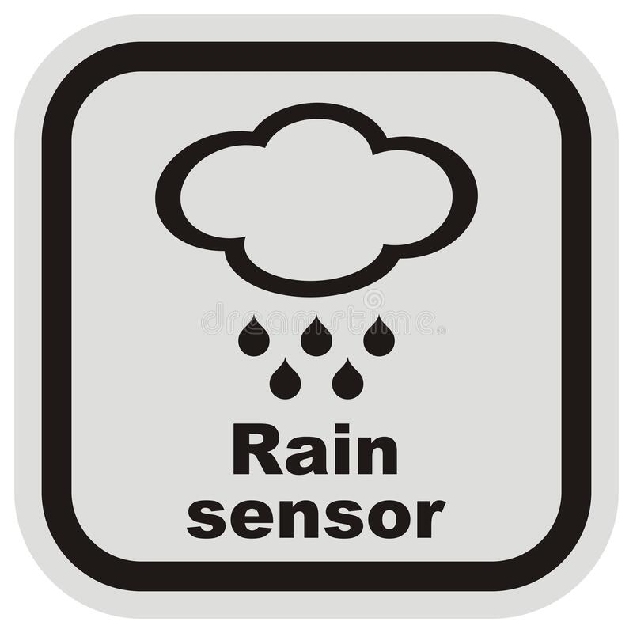
Overview
Introduction
Working Principle
Pinout Configuration
Applications
Advantages
Conclusion

Slide 3
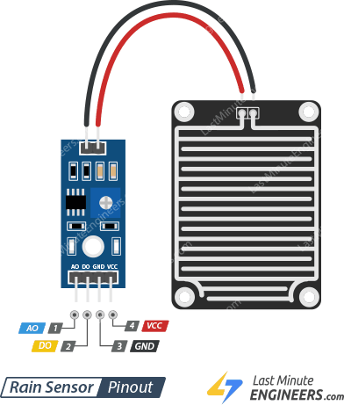
Introduction
Rain Sensor is the Magic Behind Automated Weather Detection.
It Is also Known as Rain Switch.
A rain sensor or rain switch is a switching device activated by rainfall.

Slide 4
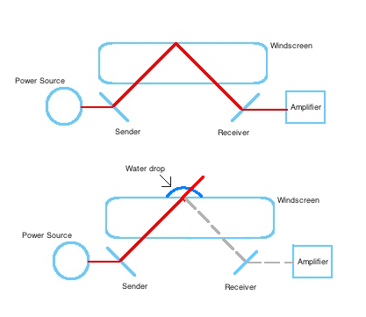
Working Principle
Rain sensors with pinout detect raindrops through conductive pins
Conductive path between pins creates electrical signal
Electrical signal activates devices like motors or relays
Adjustable sensitivity and delay timers are available in some sensors.

Slide 5
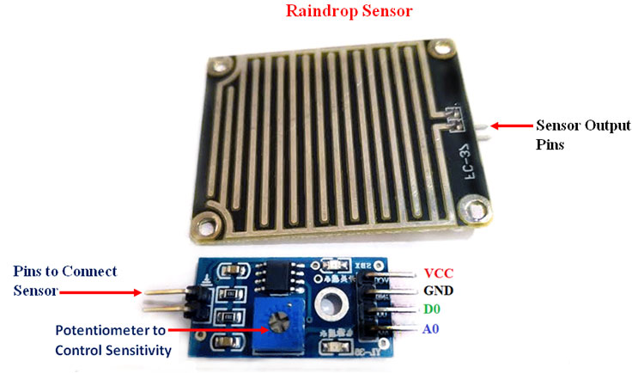
Pinout Configuration
Pin | Description
Vcc | Used For Power Supply
GND | Used for Grounding
D0 | Digital pin to get digital output
A0 | Analog pin to get analog output

Slide 6
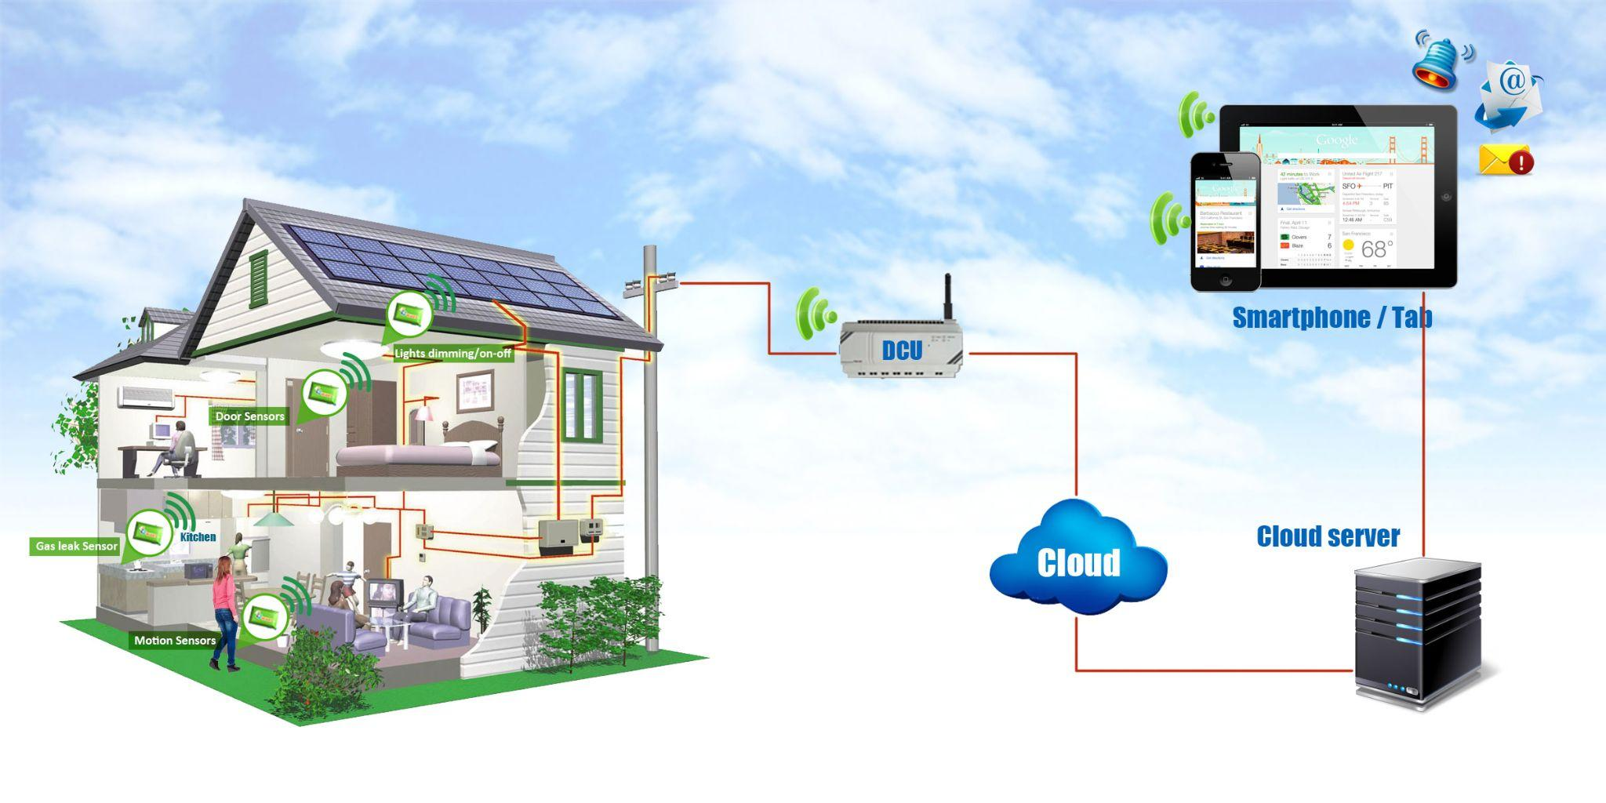

Applications
Automotive
Home automation
Industrial
windshield wipers in cars
Automotive to industrial to home automation
Automatically close windows

Slide 7
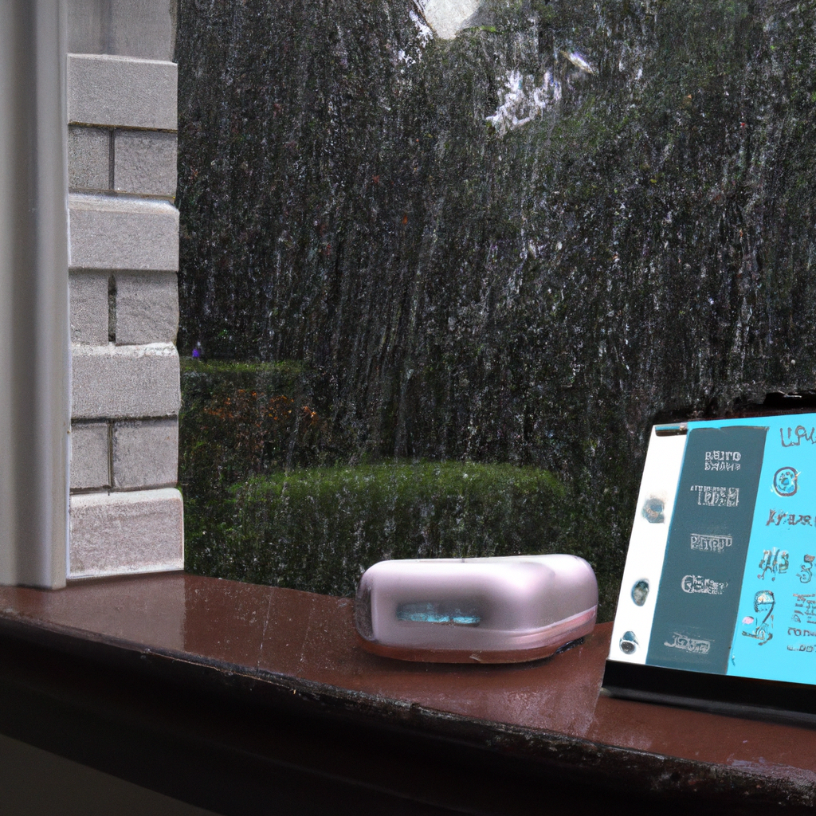
Advantages
Customizable sensitivity and delay settings allow for precise control.
Standardized pinout configuration makes integration easier.
Multiple conductive pins increase reliability and accuracy.

Slide 8
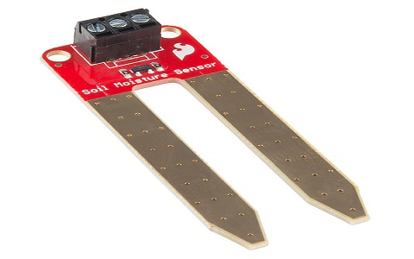
SOIL MOISTURE SENSOR
Used to measure the amount the water in soil
Measure the volumetric water content not directly with the help of some other rules of soil like :
* Dielectric constant
* electrical resistance
* interaction with neutrons

Slide 9
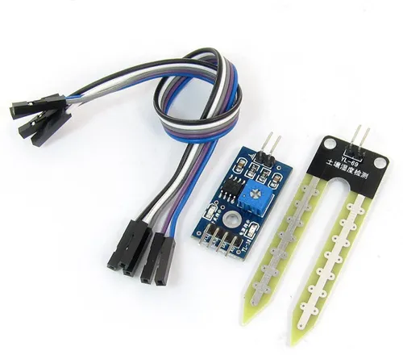
Types of Soil Moisture Sensor
→ Tensiometers
→ Gypsum blocks
→ Capacitance sensors

Slide 10
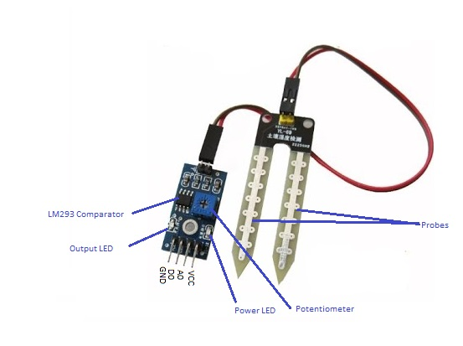
Working principle of Soil Moisture Sensor
Changes in the electrical properties of the soil
Tensiometer sensor measures the negative pressure that develops in the soil as water is drawn
A capacitance sensor measures the electrical capacitance between two metallic probes inserted into the soil

Slide 11
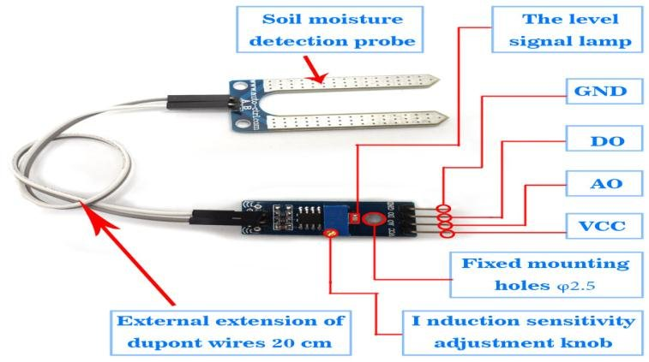
Pinout of Soil Moisture Sensor
PIN | Description
Vcc | Used for power supply, typically with +5V
A0 | Analog Out Pin for Analog Output
D0 | Digital Out Pin for Digital Output.
GND | Power Supply Ground
Sensor Probe
+ | Voltage Supply
- | -ve pin

Slide 12
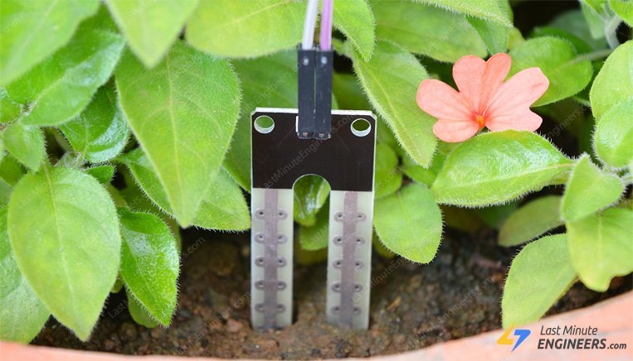
Some Applications
Agriculture
Landscape Irrigation
Research
Simple Sensor for Gardener

Slide 13
Thank You

